Slide 1
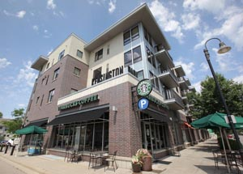
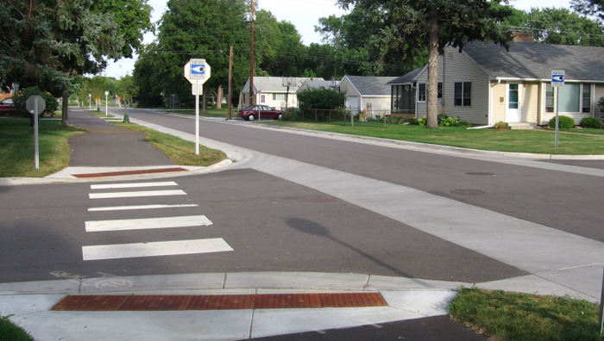
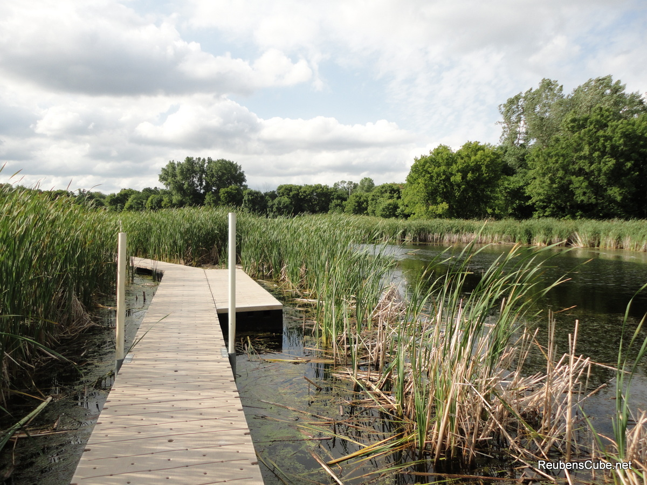
City of Richfield Comprehensive Plan Update
Advisory Committee Meeting Monday, April 10, 2017

Slide 2
Welcome
Tonight’s Talking Points
Introductions
Comprehensive Planning 101
Richfield’s 2018 Update
Public Engagement
Roles and Responsibilities
Group Exercise

Slide 3
Comprehensive planning 101
What is a Comprehensive Plan?

Slide 4
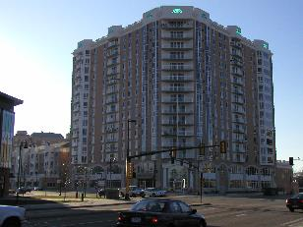
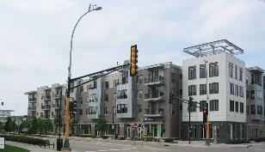
Comprehensive planning 101
Comprehensive Plans Provide:
Vision Statements and Goals
Policy Direction
Guides Growth
Twenty Year Time Horizon
Prepares for Implementation

Slide 5
Comprehensive planning 101
Minnesota State Statue
Seven County Metro Cities and Counties are required to update their plans every 10 years.
Facilitated by the Metropolitan Council
Updates need to align with regional polices (2040 Thrive MSP)

Slide 6
Comprehensive planning 101

Slide 7
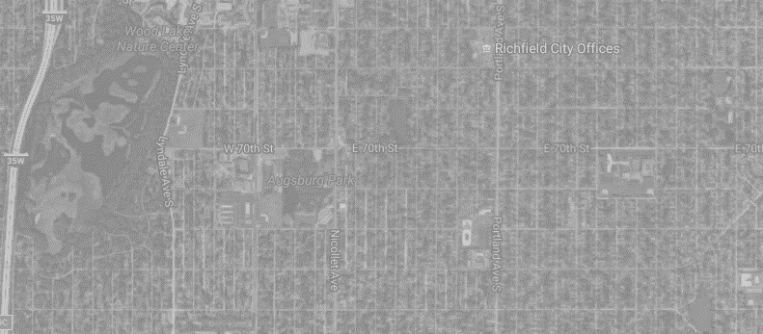
How Are We Going to Grow?
2008 Forecasts |  |  | Year | Current Forecasts
Population | Households | Jobs |  | Population | Households | Jobs
37,700 | 16,500 | 17,100 | 2010 | 35,228 | 14,818 | 15,604
41,300 | 18,000 | 17,600 | 2020 | 35,700 | 15,600 | 16,600
45,000 | 19,500 | 18,100 | 2030 | 35,600 | 16,000 | 17,100
- | - | - | 2040 | 35,900 | 16,400 | 17,500

Slide 8
Comprehensive planning 101
System Statement (see Handout)
Provides direction on…
Growth
Regional Policies
Regional Investments

Slide 9
Richfield’s Update (See Handout)
Key Tasks
Project Management
Phase I: Public Engagement and Outreach (Discovery Phase)
Phase II: Public Engagement and Outreach (Findings & Ideas)
Phase III: Public Engagement and Outreach (Draft Recommendations)
Vision and Goal Setting
Economic Competiveness & Sub Area Analysis
Multimodal Connectivity
Parks and Open Space
Implementation
Updates and Modifications to the Existing Comprehensive Plan

Slide 10
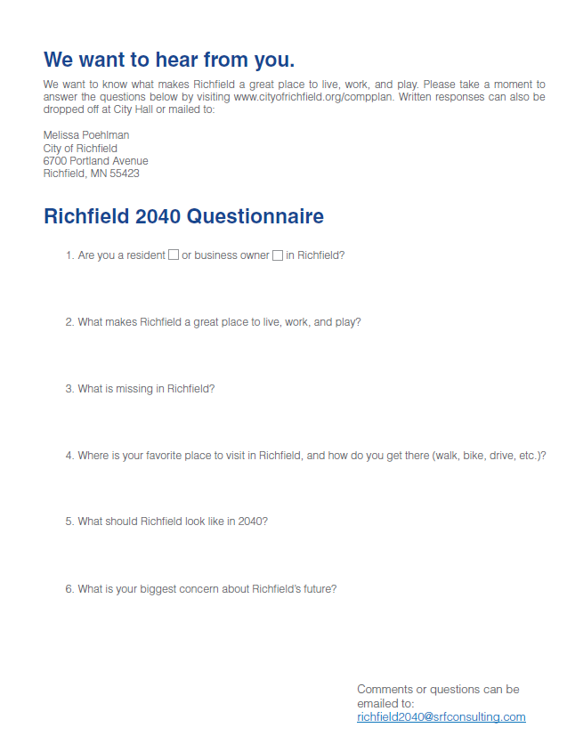
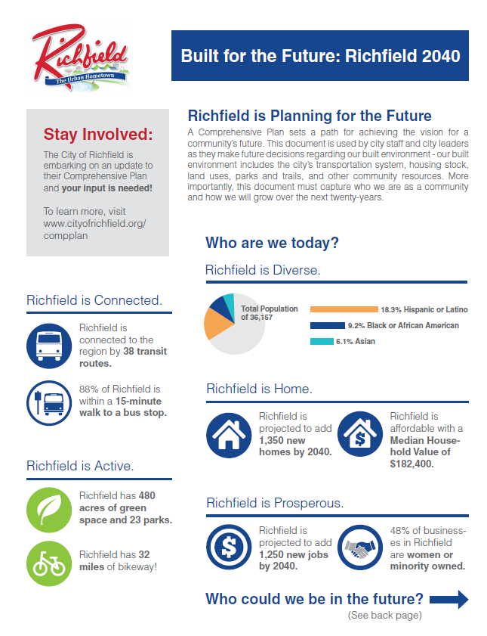
Richfield’s Update (See Handout)
Public Engagement
Pop Up Events
Online Engagement
Open Houses

Slide 11
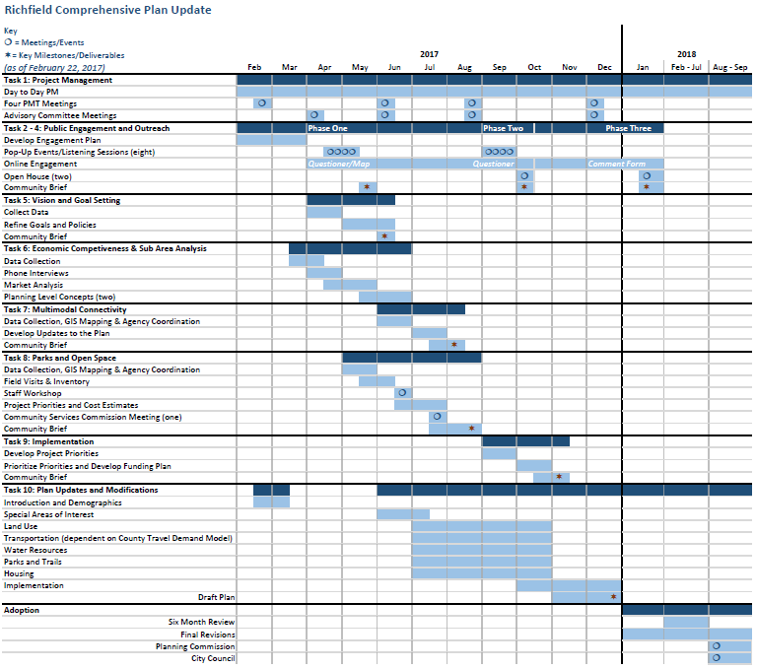
Richfield’s Update
See Handout

Slide 12
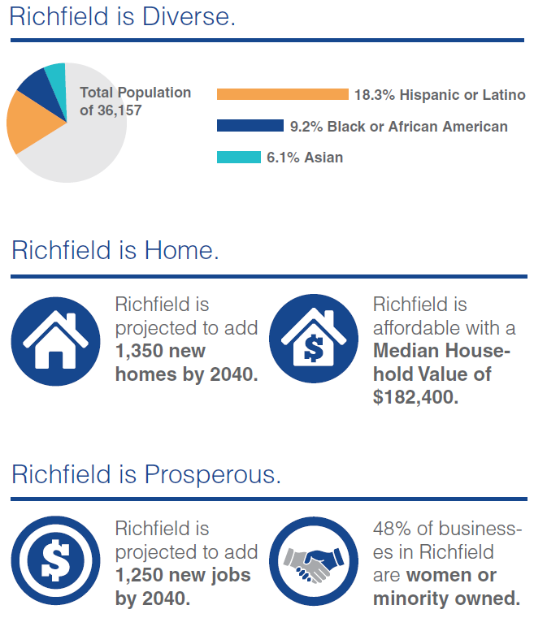
Roles & Responsibilities
You are here to help engage the community.

Slide 13
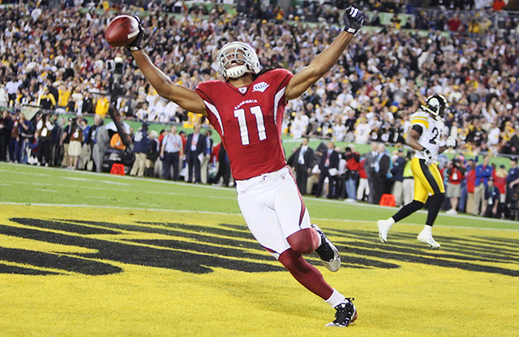
Roles & Responsibilities
Meet 3 more times – see handout
To provide guidance and direction
To be champions of the process
To engage others
NFL Prow Bowler, Larry Fitzgerald –
Academy of Holy Angels Alumni

Slide 14
Questions & Discussions
Advisory Committee Meeting Monday, April 10, 2017

